Slide 1


Licensing of research outputs
Korbinian Bösl
Data management coordinator
Centre for Digital Life & ELIXIR Norway
10 November 2023

Slide 2
Objectives
? Questions
What is intellectual property/copyright/derivative work?
What is free software/data?
What types of licenses exist?
! Objectives
Get familiar with terminology around licensing
Discuss what is and is not derivative work
CC-BY 4.0 coderefinery

Slide 3

Intellectual property rights (IPRs)
Patent: Protects novel, non-obvious, inventions
Copyright: creative products: software, writing, figures, photos, some datasets, this presentation
Trademark: Protects a name/brand
CC-BY 3.0 Wichai.Wi

Slide 4
Intellectual property rights (IPRs)
Patent: Protects novel, non-obvious, inventions
Copyright: creative products: software, writing, figures, photos, some datasets, this presentation
Trademark: Protects a name/brand
CC-BY 3.0 Wichai.Wi
IPR often regulated in work contract

Slide 5
Software patents in Europe
(it’s complicated)
The European Patent Convention states that software is not patentable. in contrast with e.g. the US
The European Patents Office (EPO) grants software patents by declaring them as "computer implemented inventions".
Erosions: VICOM 1986, COMVIK 2002, ML guidelines 2018, Bentley 2021
http://www.epo.org/law-practice/legal-texts/html/epc/2013/e/ar52.html

Slide 6
Patents in Europe
Active process
No prior disclosure
Apply only in limited geographical scopes
Fees (varying by business size and scope)
Apply for max 20 years after application
https://www.digitallifenorway.org/conference/2021/digital-life-2021-know-how-workshop-ipr.html

Slide 7
Copyright in Europe
Creative products: software, writing, figures, photos,...
Applies by default
Does not apply for facts
Economic rights vs. moral rights
Author lifetime + 70 years
Commons:Copyright rules by territory/Norway

Slide 8
https://www.mentimeter.com/app/presentation/fe969a5e9cdeeee514c347ef1458b89b/3e225f5834c4

Slide 9
Licensing
A licensor may grant a license under intellectual property laws to authorize a use (such as copying software or using a patented invention) to a licensee, sparing the licensee from a claim of infringement brought by the licensor.
CC-BY-SA 3.0 License - Wikipedia

Slide 10
Why should I licence my research outputs?

Slide 11

Why should I licence my research outputs?
Legal security for users (Accessibility)

Slide 12

Why should I licence my research outputs?
Legal security for users (Accessibility)
Increase of willingness to reuse outputs (Reusability)

Slide 13

Why should I licence my research outputs?
Legal security for users (Accessibility)
Increase of willingness to reuse outputs (Reusability)
Allows deposition/mirroring in 2nd databases (Findability)

Slide 14

Concepts in open licenses
Waive all your interests that may exist in your work
Copy left:
Icons CC-BY 4.0 https://creativecommons.org/

Slide 15

Concepts in open licenses
Waive all your interests that may exist in your work
Copy left:
Credit for the original creation
Icons CC-BY 4.0 https://creativecommons.org/

Slide 16

Concepts in open licenses
Waive all your interests that may exist in your work
Copy left:
Credit for the original creation
License new creations under identical terms
Icons CC-BY 4.0 https://creativecommons.org/

Slide 17

Concepts in open licenses
Waive all your interests that may exist in your work
Copy left:
Credit for the original creation
License new creations under identical terms
Non-commercial
Icons CC-BY 4.0 https://creativecommons.org/

Slide 18

Concepts in open licenses
Waive all your interests that may exist in your work
Copy left:
Credit for the original creation
License new creations under identical terms
Non-commercial
Cannot be shared with others in adapted form
Icons CC-BY 4.0 https://creativecommons.org/

Slide 19


CC-BY 4.0 Shaddim; original CC license symbols by https://creativecommons.org/

Slide 20
CC-BY 4.0 Shaddim; original CC license symbols by https://creativecommons.org/

Slide 21
CC-BY 4.0 Shaddim; original CC license symbols by https://creativecommons.org/

Slide 22
CC-BY 4.0 Shaddim; original CC license symbols by https://creativecommons.org/

Slide 23
CC-BY 4.0 Shaddim; original CC license symbols by https://creativecommons.org/

Slide 24
CC-BY 4.0 Shaddim; original CC license symbols by https://creativecommons.org/

Slide 25
CC-BY 4.0 Shaddim; original CC license symbols by https://creativecommons.org/

Slide 26
CC-BY 4.0 Shaddim; original CC license symbols by https://creativecommons.org/

Slide 27
CC-BY 4.0 Shaddim; original CC license symbols by https://creativecommons.org/

Slide 28
CC-BY 4.0 Shaddim; original CC license symbols by https://creativecommons.org/

Slide 29
“open”
CC-BY 4.0 Shaddim; original CC license symbols by https://creativecommons.org/

Slide 30

Legal code, harmonized for national/international law
Creative Commons, Nathan Yergler, Alex Roberts. Licensed to the public under CC BY 3.0 Unported. Creative Commons logo used under CC Trademark Policy.

Slide 31

Legal code, harmonized for national/international law
Human readable, understandable text
Creative Commons - What is licensed?
Nathan Yergler, Alex Roberts - Who is to be attributed?
Licensed to the public under CC BY 3.0 Unported - Which license?
Creative Commons, Nathan Yergler, Alex Roberts. Licensed to the public under CC BY 3.0 Unported. Creative Commons logo used under CC Trademark Policy.

Slide 32

Legal code, harmonized for national/international law
Human readable, understandable text
Machine readable html tag attachable to metadata
Creative Commons, Nathan Yergler, Alex Roberts. Licensed to the public under CC BY 3.0 Unported. Creative Commons logo used under CC Trademark Policy.

Slide 33
Challenges
CC-BY 4.0 license symbols by https://creativecommons.org/

Slide 34
Challenges
Multiple Attributions for several sources (license stacking)
CC-BY 4.0 license symbols by https://creativecommons.org/

Slide 35
Challenges
Multiple Attributions for several sources (license stacking)
Multiple incompatible source licenses
CC-BY 4.0 license symbols by https://creativecommons.org/

Slide 36
Challenges
Multiple Attributions for several sources (license stacking)
Multiple incompatible source licenses
Legal commercial definition (e.g. use by journals)
CC-BY 4.0 license symbols by https://creativecommons.org/

Slide 37
Challenges
Multiple Attributions for several sources (license stacking)
Multiple incompatible source licenses
Legal commercial definition (e.g. use by journals)
Unintentional restrictive
CC-BY 4.0 license symbols by https://creativecommons.org/

Slide 38

Open Data Commons
Databases are different to simple data (e.g. EU-copyright)
Icons CC-BY 4.0 https://creativecommons.org/
https://opendatacommons.org

Slide 39
Open Data Commons
Databases are different to simple data (e.g. EU-copyright)
Open Data Commons Public Domain Dedication and License (PDDL)
Icons CC-BY 4.0 https://creativecommons.org/
https://opendatacommons.org

Slide 40
Open Data Commons
Databases are different to simple data (e.g. EU-copyright)
Open Data Commons Public Domain Dedication and License (PDDL)
Open Data Commons Attribution License (ODC-By)
Icons CC-BY 4.0 https://creativecommons.org/
https://opendatacommons.org

Slide 41
Open Data Commons
Databases are different to simple data (e.g. EU-copyright)
Open Data Commons Public Domain Dedication and License (PDDL)
Open Data Commons Attribution License (ODC-By)
Open Data Commons Open Database License (ODbL)
Icons CC-BY 4.0 https://creativecommons.org/
https://opendatacommons.org

Slide 42


Norwegian Licence for Open Government Data (NLOD) 2.0
Icons CC-BY 4.0
https://creativecommons.org/
https://data.norge.no/norwegian-licence-open-government-data-nlod-20

Slide 43
Norwegian Licence for Open Government Data (NLOD) 2.0
A licence compatible by contract shall mean the following licences:
for all information: Open Government Licence (version 1.0, 2.0 and 3.0), Creative Commons Attribution Licence (international version 4.0 and norwegian version 4.0)
for those parts of the information which do not constitute databases: Creative Commons Attribution Licence (generic version 1.0, 2.0, 2.5 and unported version 3.0) and Creative Commons Navngivelse 3.0 Norge
for those parts of the information which constitute databases: Open Data Commons Attribution License (version 1.0).
Icons CC-BY 4.0
https://creativecommons.org/
https://data.norge.no/norwegian-licence-open-government-data-nlod-20

Slide 44

Norwegian Licence for Open Government Data (NLOD) 2.0
A licence compatible by contract shall mean the following licences:
for all information: Open Government Licence (version 1.0, 2.0 and 3.0), Creative Commons Attribution Licence (international version 4.0 and norwegian version 4.0)
for those parts of the information which do not constitute databases: Creative Commons Attribution Licence (generic version 1.0, 2.0, 2.5 and unported version 3.0) and Creative Commons Navngivelse 3.0 Norge
for those parts of the information which constitute databases: Open Data Commons Attribution License (version 1.0).
Icons CC-BY 4.0
https://creativecommons.org/
https://data.norge.no/norwegian-licence-open-government-data-nlod-20

Slide 45
Open Source Software licenses
Special considerations for Software
Liability
Warranty
Modifications
Network use = Distribution?

Slide 46



Open Source Software licenses
Icons CC-BY 4.0
https://creativecommons.org/

Slide 47
Open Source Software licenses
GNU AGPLv3
MIT license
Icons CC-BY 4.0
https://creativecommons.org/

Slide 48
Open Source Software licenses
BSD licenses
GNU AGPLv3
MIT license
GNU GPLv3
GNU LGPLv3
Apache 2.0
Icons CC-BY 4.0
https://creativecommons.org/

Slide 49

Open Source Software licenses
BSD licenses
GNU AGPLv3
MIT license
GNU GPLv3
GNU LGPLv3
Apache 2.0
https://opensource.org/licenses
https://choosealicense.com/
Icons CC-BY 4.0
https://creativecommons.org/

Slide 50

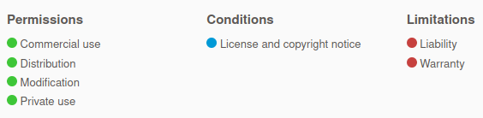
MIT
BSD
Icon CC-BY 4.0 http://software-carpentry.org; Image unchanged from https://choosealicense.com/

Slide 51
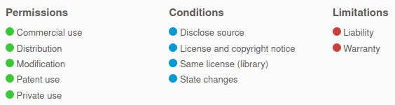
weak
LGPL
MPL
Icon CC-BY 4.0 http://software-carpentry.org; Image unchanged from https://choosealicense.com/

Slide 52
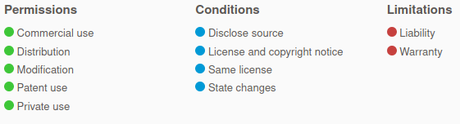
strong
GPL
AGPL
Icon CC-BY 4.0 http://software-carpentry.org; Image unchanged from https://choosealicense.com/

Slide 53
Open Source Software licenses
CC-BY 4.0
http://software-carpentry.org/

Slide 54
Open Source Software licenses
CC-BY 4.0
http://software-carpentry.org/

Slide 55
Open Source Software licenses
CC-BY 4.0
http://software-carpentry.org/

Slide 56
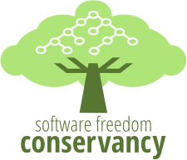

Does it hold in court?
Yes!
Busybox GPL lawsuits 2007-2009
Free Software Foundation, Inc. v. Cisco Systems, Inc., 2009
…

Slide 57
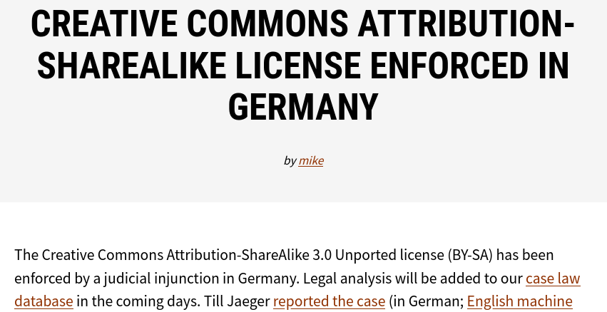
Does it hold in court?
Yes!
https://creativecommons.org/2011/09/15/creative-commons-attribution-sharealike-license-enforced-in-germany/

Slide 58
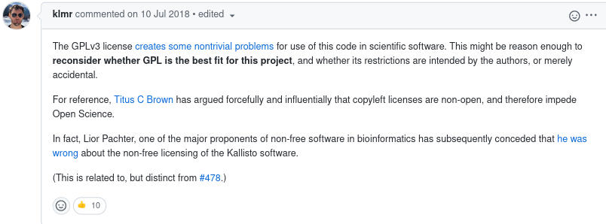
Unintended consequences
https://github.com/nextflow-io/nextflow/issues/788

Slide 59
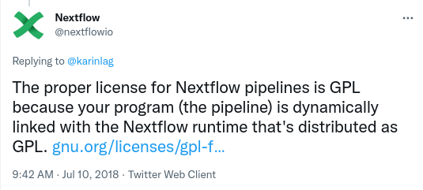
Unintended consequences
However, this was not our original intention. We don’t consider workflow applications to be subject to the GPL copyleft obligations of the GPL even though they may link dynamically to Nextflow functionality through normal calls and we are not interested to enforce the license requirement to third party workflow developers and organizations.
https://www.nextflow.io/blog/2018/clarification-about-nextflow-license.html

Slide 60
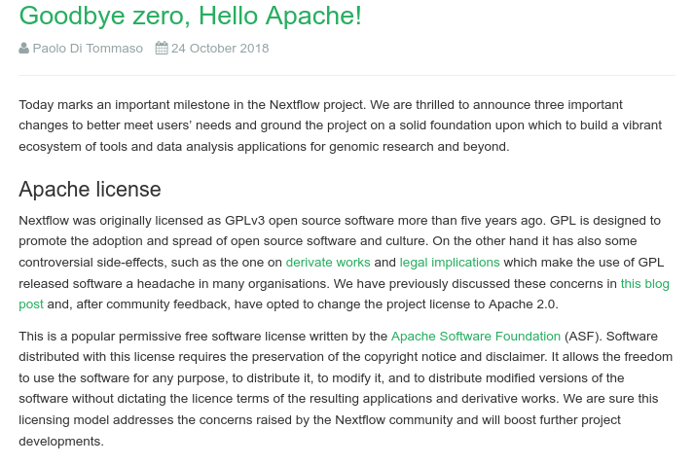
Unintended consequences
https://www.nextflow.io/blog/2018/goodbye-zero-hello-apache.html

Slide 61
What is the StackOverflow license for code you copy and paste?
A journal requests that you release your software during publication. You have copied a portion of the code from another package, which you have forgotten. Can you satisfy the journal’s request?
You want to fix a bug in a project someone else has released, but there is no license. What risks are there?
How would you ask someone to add a license?
You incorporate MIT, GPL, and BSD3 licensed code into your project. What possible licenses can you pick for your project?
You do the same as above but add in another license that looks viral. What possible licenses can you use now?
Do licenses apply if you don’t distribute your code? Why or why not?
Which licenses are most/least attractive for companies with proprietary software?
CC-BY 4.0 https://coderefinery.github.io/social-coding/licensing/#exercises-licensing

Slide 62
DO
Alway add a (standard) license
Be aware of the IPR situation of the code you (re-)use
Invent your own license
DON’T

Slide 63
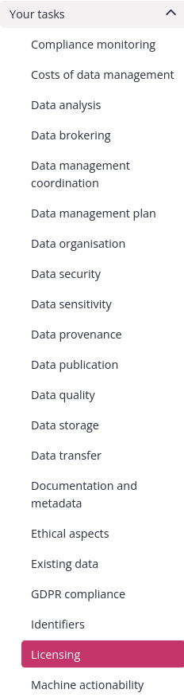


Link to RDMkit: https://rdmkit.elixir-europe.org/

Slide 64


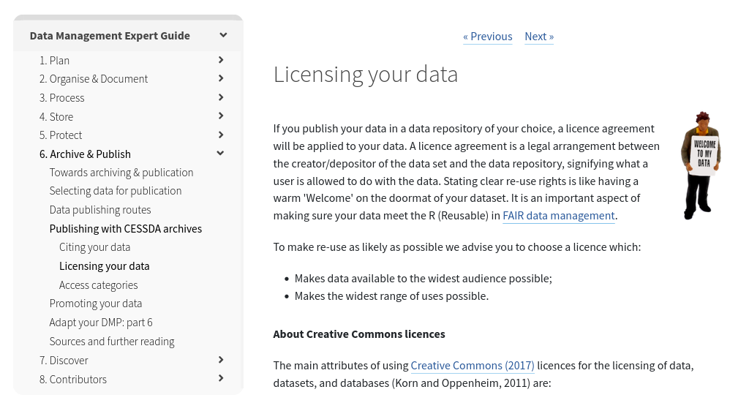
Data Management Expert Guide (DMEG)
https://dmeg.cessda.eu/Data-Management-Expert-Guide

Slide 65

Further reading
Digital Life 2021: Know-how workshop on IPR in digital biotech
Data life cycle: Sharing | RDMkit
Your tasks: Licensing | RDMkit
EUDAT license chooser for data and software
Choose a License
Licenses & Standards | Open Source Initiative
Notes:
To learn more about <session or topic name>, we recommend you to visit:

Slide 66
As indicated here, all publicly accessible user contributions are licensed under Creative Commons Attribution-ShareAlike license. See Stackoverflow Terms of service for more detailed information.
“Standard” licensing rules apply. So in this case, you would need to remove the portion of code you have copied from another package before being able to release your software.
By default you are no authorized to use the content of a repository when there is no license. And derivative work is also not possible by default. Other risks: it may not be clear whether you can use and distribute (publish) the bugfixed code. For the repo owners it may not be clear whether they can use and distributed the bugfixed code. However, the authors may have forgotten to add a license so we suggest you to contact the authors (e.g. make an issue) and ask whether they are willing to add a license.
As mentionned in 3., the easiest is to fill an issue and explain the reasons why you would like to use this software (or update it).
Combining software with different licenses can be tricky and it is important to understand compatibilities (or lack of compatibilities) of the various licenses. GPL license is the most protective (BSD and MIT are quite permissive) so for the resulting combined software you could use a GPL license. However, re-licensing may not be necessary.
Derivative work would need to be shared under this viral license (e.g. AGPL or GPL), unless the components are only plugins or libraries.
If you keep your code for yourself, you may think you do not need a license. However, remember that in most companies/universities, your employer is “owning” your work and when you leave you may not be allowed to “distribute your code to your future self”. So the best is always to add a license!
The least attractive licenses for companies with proprietary software are licenses where you would need to keep an open license when creating derivative work. For instance GPL and and AGPL. The most attractive licenses are permissive licenses where they can reuse, modify and relicense with no conditions. For instance MIT, BSD and Apache License.
CC-BY 4.0 https://coderefinery.github.io/social-coding/licensing/#exercises-licensing

Slide 67

Thank you!
elixir-norway.org
digitallifenorway.org
contact@elixir.no
contact@digitallifenorway.org
korbinian.bosl@uib.no
@elixirnorway
@DigitaltLiv
@BoslKorbinian
Except where otherwise noted, this work is licensed under a
Creative Commons Attribution 4.0 International License
https://creativecommons.org/licenses/by/4.0/

